Slide 1
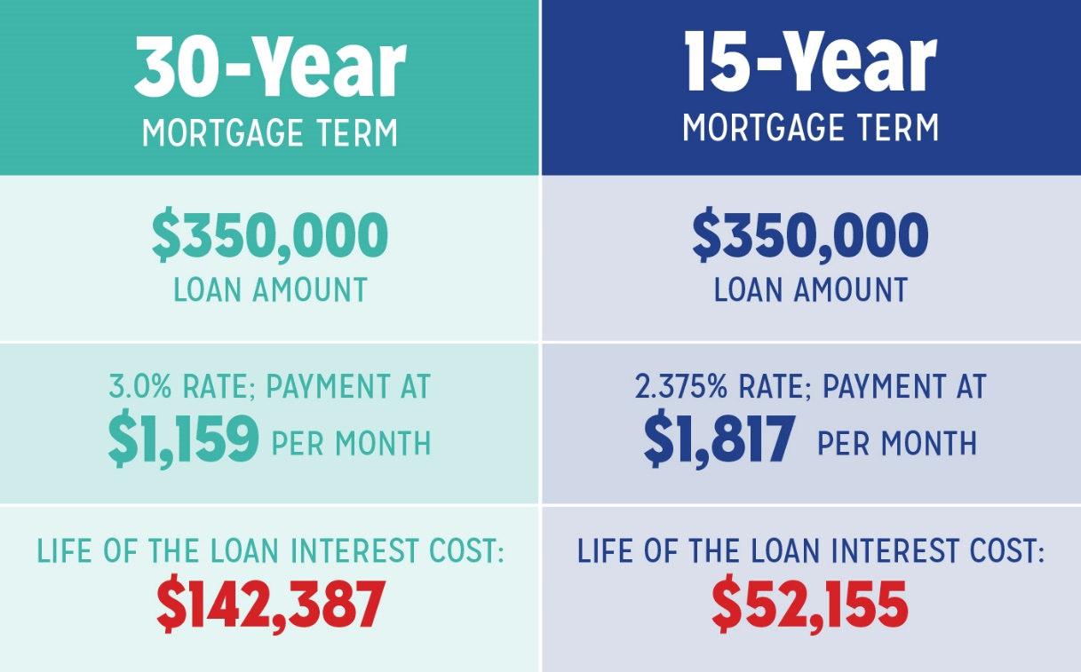
Learning Target: I can calculate and compare the differences between a 30-Year Mortgage and a 15-Year Mortgage, using information from a home currently for sale on the MLS and choose which mortgage would be most beneficial for myself and my potential family.
Do Now: What are the differences between a 30-year mortgage and 15-year mortgage?
Lesson/ discussion
Lab time
Ticket out the door

Slide 2



Learning Target: I can calculate and compare the differences between a 30-Year Mortgage and a 15-Year Mortgage, using information from a home currently for sale on the MLS and choose which mortgage would be most beneficial for myself and my potential family.
New Terms
Mortgage - A loan used to purchase a house.
Principal - The money borrowed from the bank (lender), which has to be paid back.
Interest - The money the bank charges you for lending you the money.
Property Taxes - The money paid to the local government for schools and county services - based on value of the property.
House Insurance - Insurance that covers losses and damages to an individual's house (fire, wind damage, etc) and assets in the home (damage, theft, etc).

Slide 3
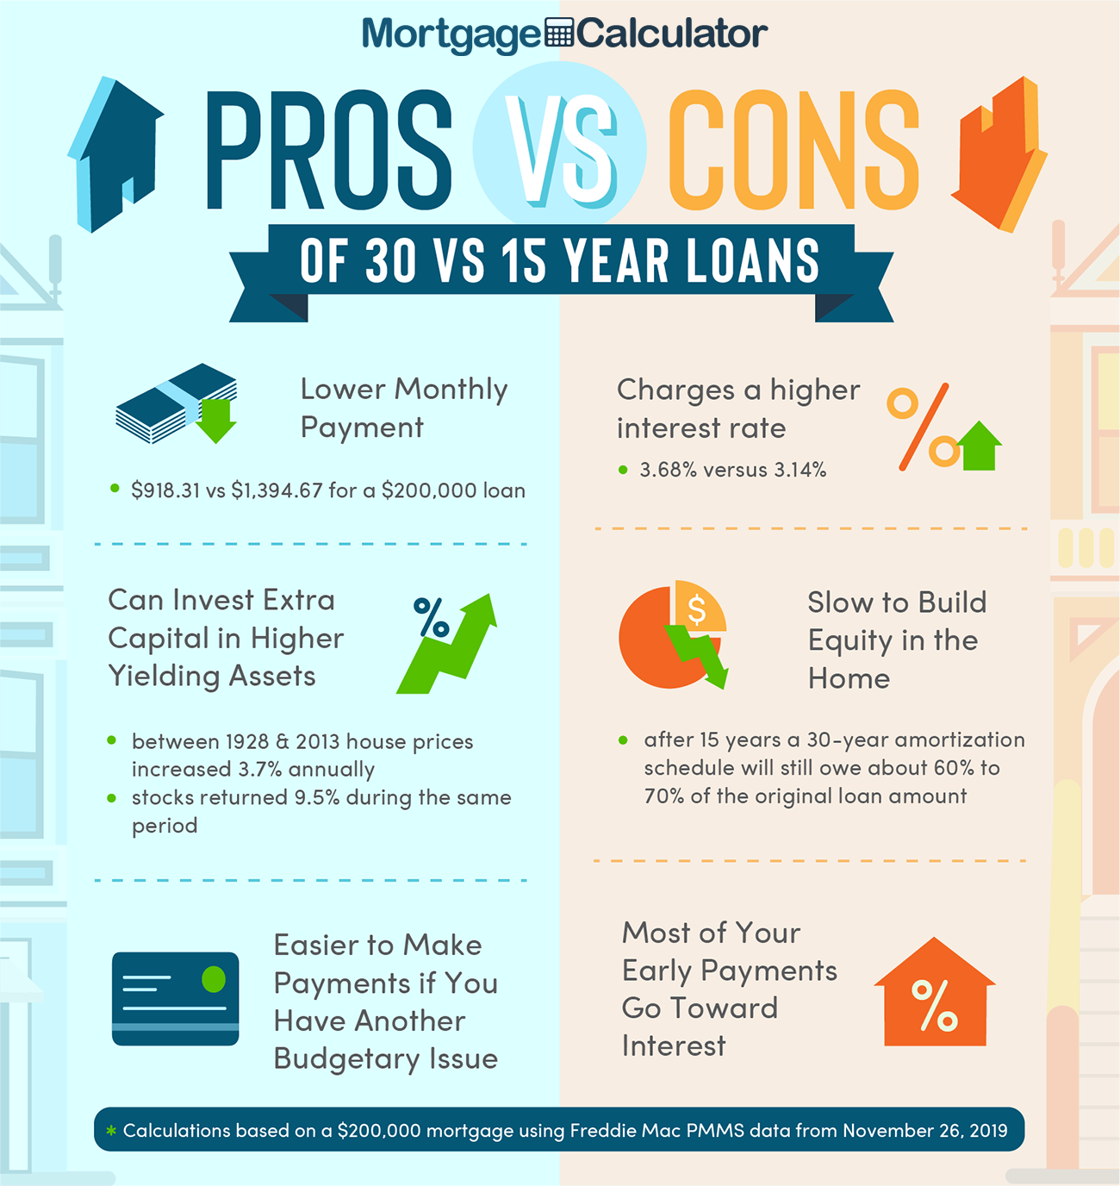
VOO
Learning Target: I can calculate and compare the differences between a 30-Year Mortgage and a 15-Year Mortgage, using information from a home currently for sale on the MLS and choose which mortgage would be most beneficial for myself and my potential family.

Slide 4
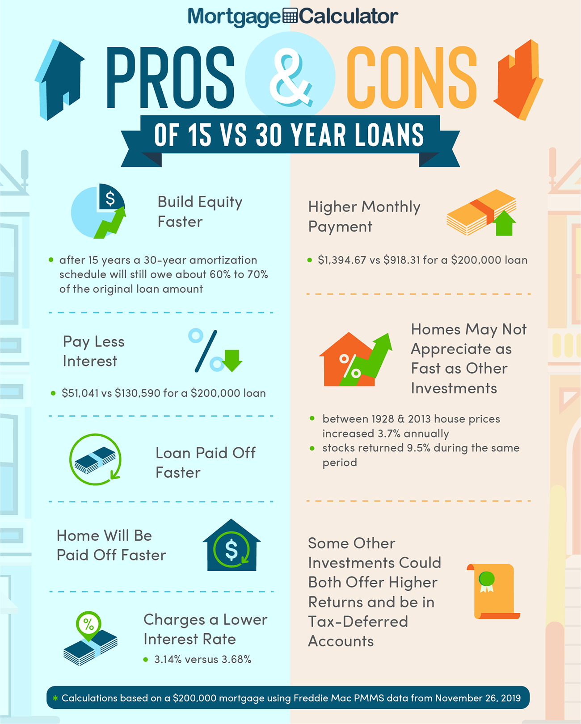
Learning Target: I can calculate and compare the differences between a 30-Year Mortgage and a 15-Year Mortgage, using information from a home currently for sale on the MLS and choose which mortgage would be most beneficial for myself and my potential family.

Slide 5
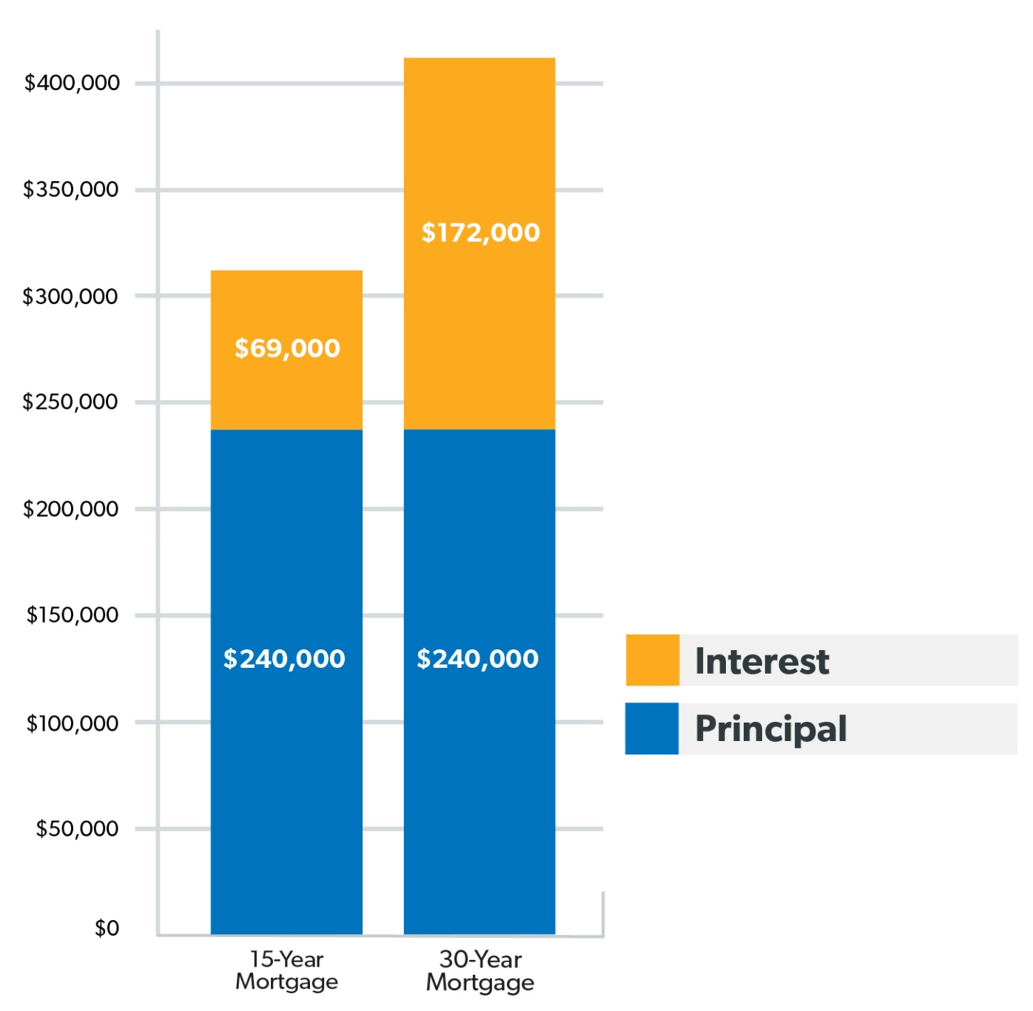
Learning Target: I can calculate and compare the differences between a 30-Year Mortgage and a 15-Year Mortgage, using information from a home currently for sale on the MLS and choose which mortgage would be most beneficial for myself and my potential family.

Slide 6




Where do you find houses for sale?
Learning Target: I can calculate and compare the differences between a 30-Year Mortgage and a 15-Year Mortgage, using information from a home currently for sale on the MLS and choose which mortgage would be most beneficial for myself and my potential family.
Zillow
Realtor.com
GoMLS – for your phone
Real Estate Agents – daily listings via email

Slide 7
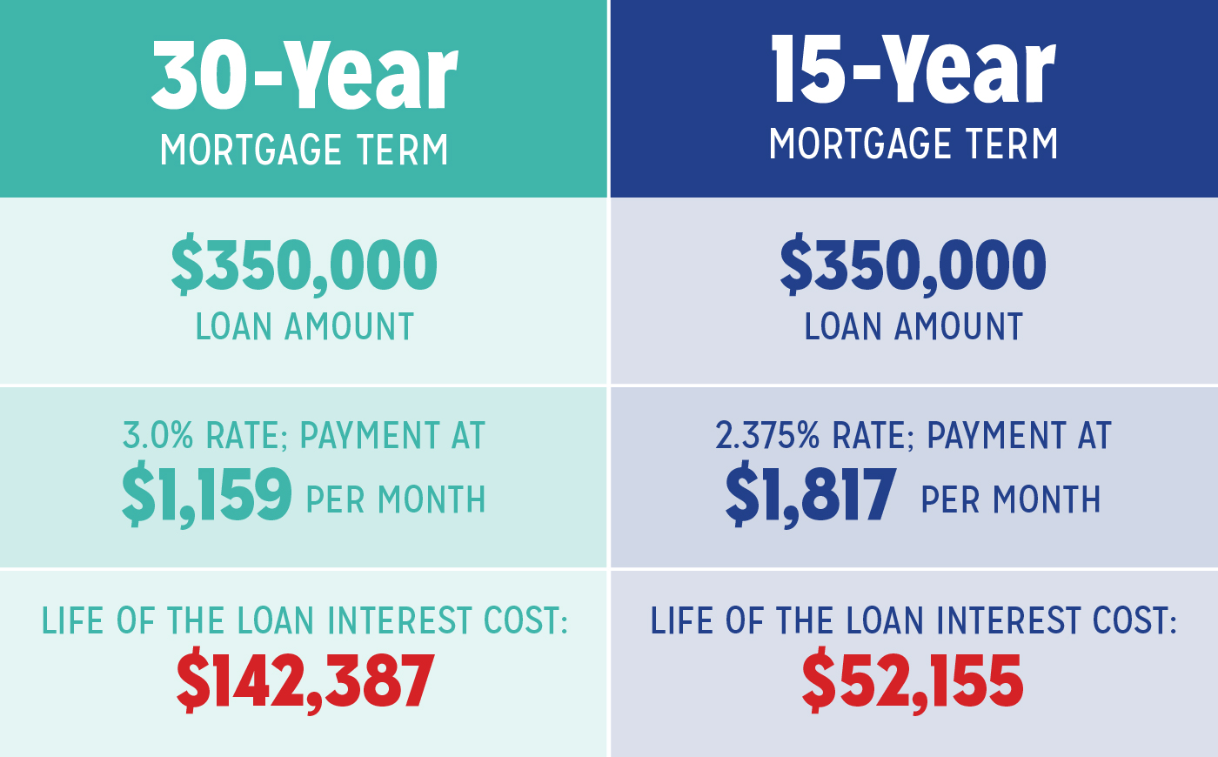
Learning Target: I can draw and illustrate what each step of the House Purchasing Process looks like, and summarize the process used in order to purchase a house.

Slide 8
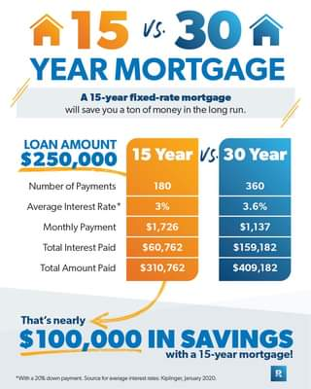
Learning Target: I can draw and illustrate what each step of the House Purchasing Process looks like, and summarize the process used in order to purchase a house.

Slide 9

Learning Target: I can draw and illustrate what each step of the House Purchasing Process looks like, and summarize the process used in order to purchase a house.
Ticket out the door:
Which would you sign up for?
30-year or 15-year loan? Why?

